Slide 1
Screening diagnostic markers for
Acute Myeloid Leukemia based (AML)
On bioinformatics analysis
Sharif University of Technology
Mobina Poulaei and Ali Abdoshahi
Winter-2025

Slide 2
Introduction
Acute Myeloid Leukemia (AML):
Aggressive hematologic malignancy with high mortality
Early diagnosis is critical for improving treatment outcomes.
Need for Biomarkers:
Identification of key molecules can aid in early screening, diagnosis, and development of targeted therapies.
Bioinformatics Role:
Integration of large-scale datasets to discover differentially expressed genes (DEGs).

Slide 3
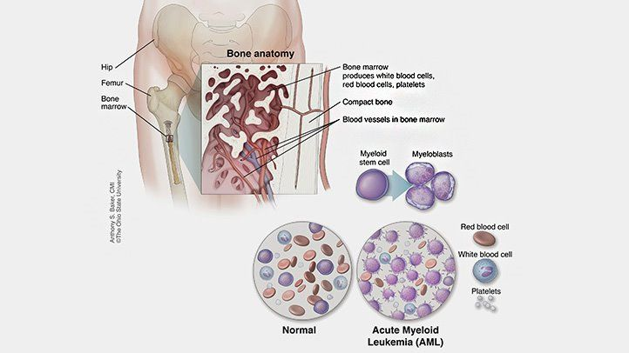
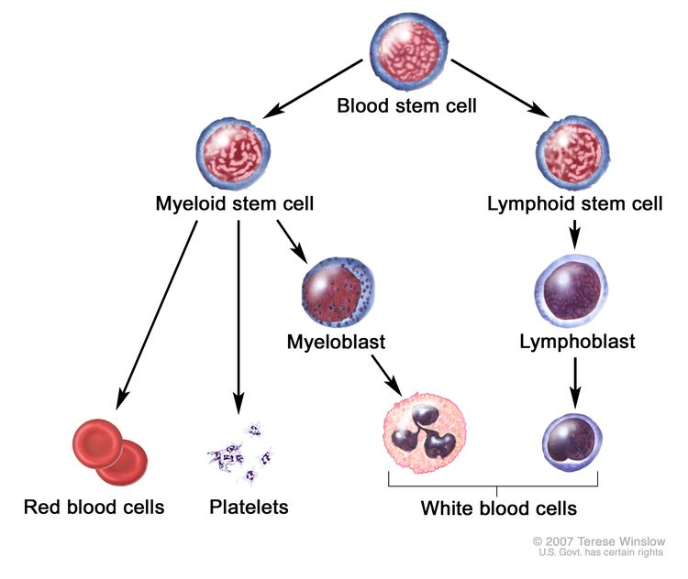
What is Acute Myeloid Leukemia
fast-growing blood cancer that originates in the bone marrow and affects myeloid progenitor cells. These abnormal cells fail to mature properly and accumulate, leading to a disruption of normal blood cell production.

Slide 4
Data sets
 | GSE24395 | GSE30029
Platform | Sentrix Human-6 v2 Expression BeadChip | Illumina HumanHT-12 V3.0 Expression BeadChip
Country | Japan | Netherlands
Last Update | 2013 | 2018
GEO Annotation | GPL6106 | GPL6947
# of Normal / AML | 5 / 12 | 31 / 90

Slide 5
Methods
Data Collection:
Transcriptional datasets from Gene Expression Omnibus (GEO).
Differential Expression Analysis:
R software and Limma package to identify DEGs.
Enrichment Analyses:
Gene Ontology (GO) and pathway databases (KEGG, Reactome, BioPlanet, Panther) to determine biological functions and pathways.

Slide 6
Methods (Cont.)
Feature Selection:
Random forest algorithm to identify genes with high diagnostic potential.
Diagnostic Validation:
Receiver Operator Characteristic (ROC) curve to assess diagnostic performance.
Immune Correlation:
ESTIMATE algorithm used to calculate stromal/immune scores and assess correlations with gene expression.

Slide 7
EDA

Slide 8
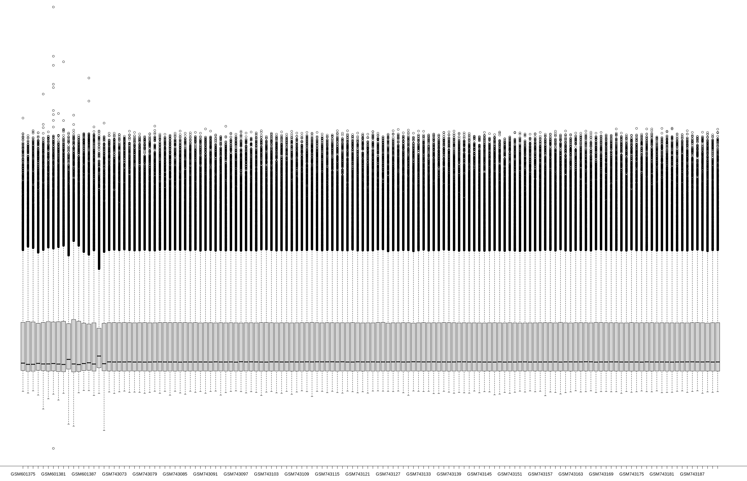
Box plot

Slide 9
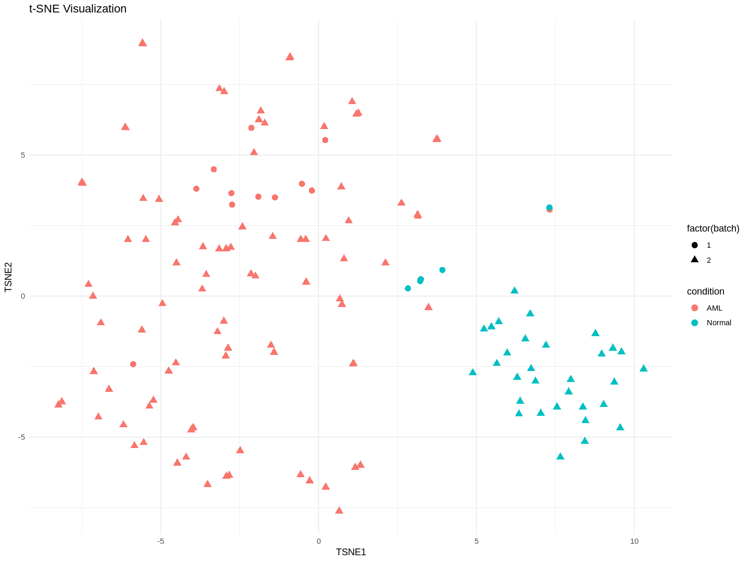
tSNE

Slide 10
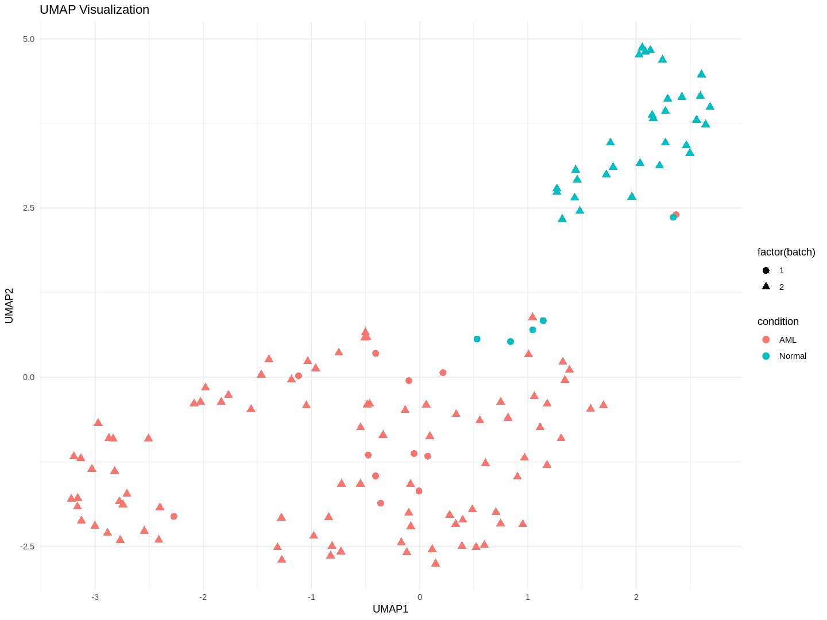
UMAP

Slide 11
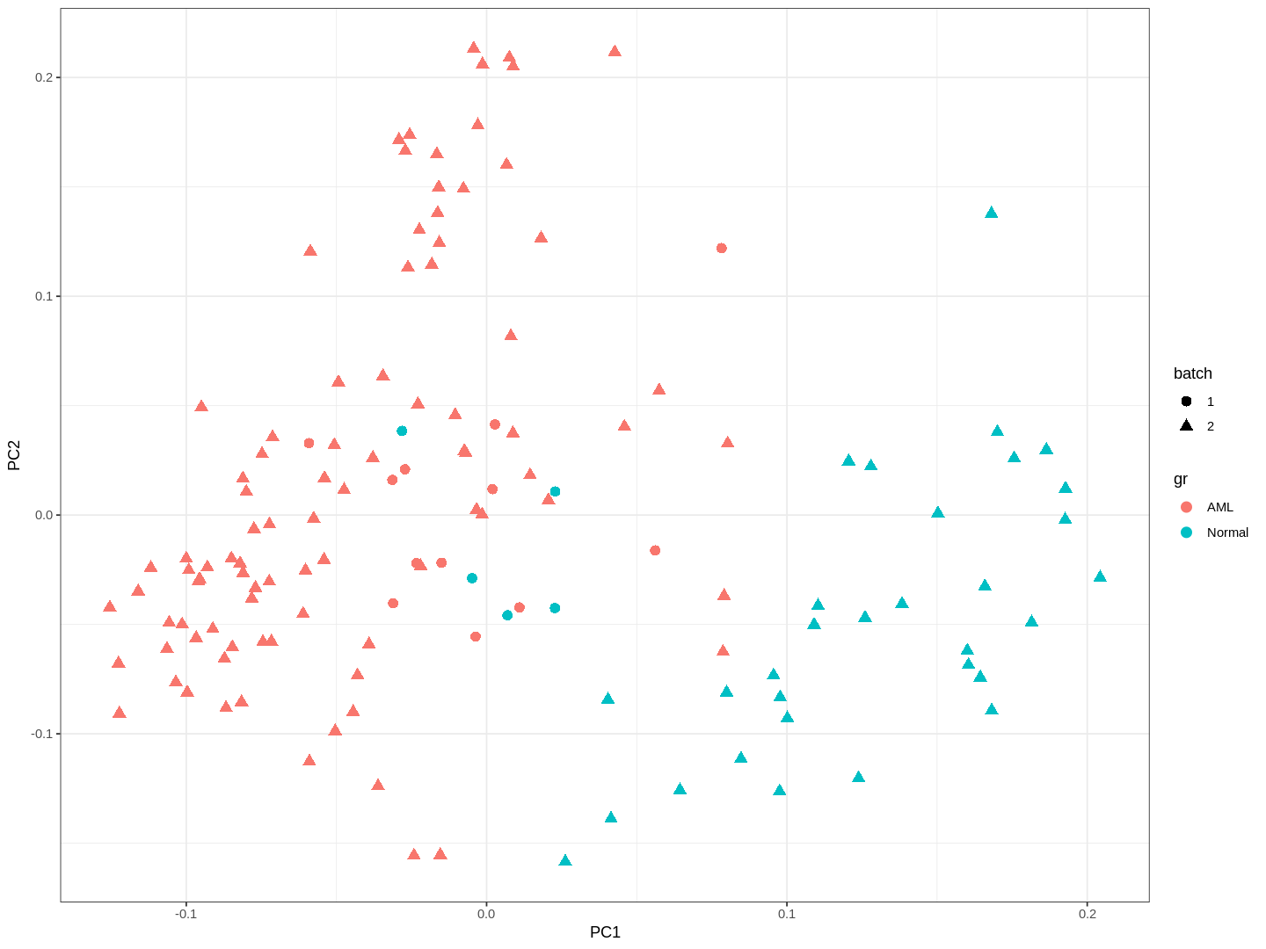
PCA

Slide 12
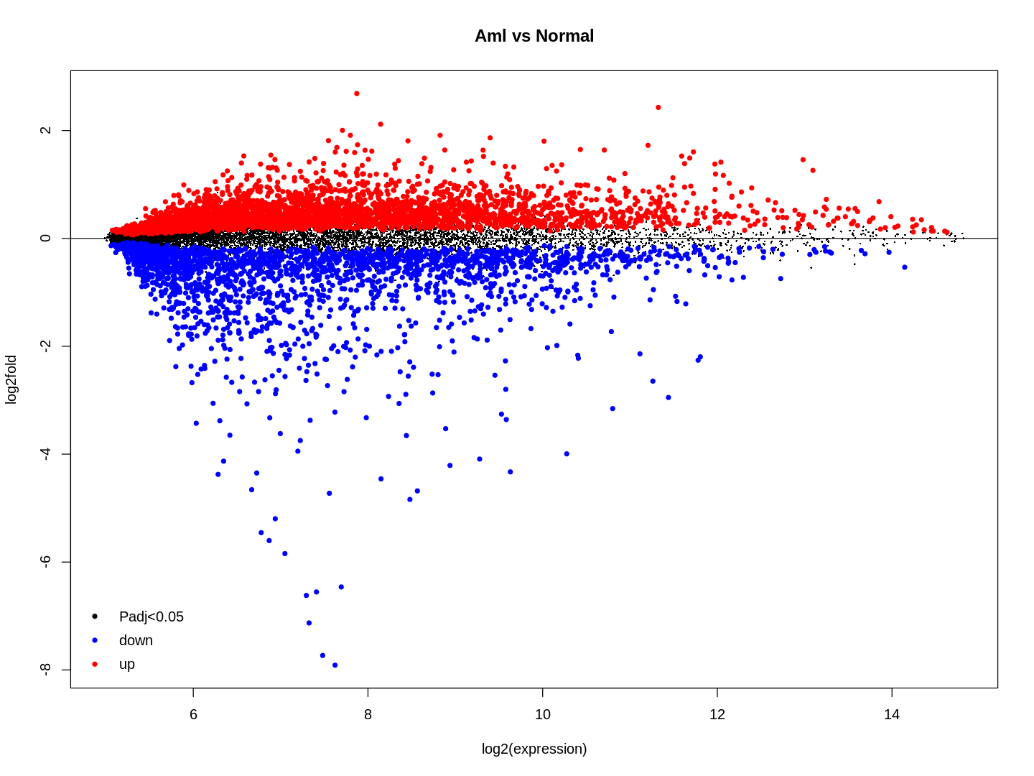
Mean difference (MD) plot

Slide 13
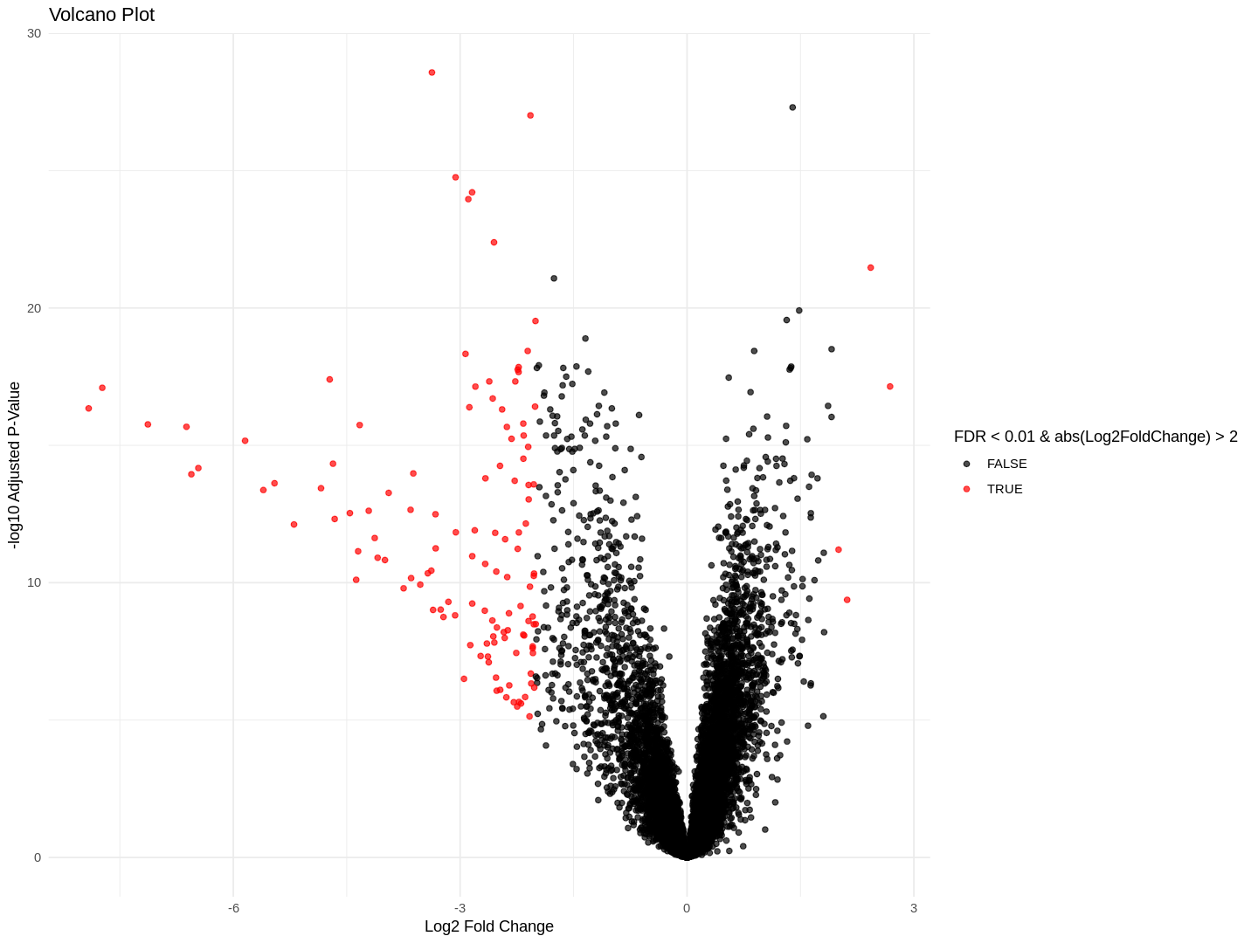
Volcano plot

Slide 14
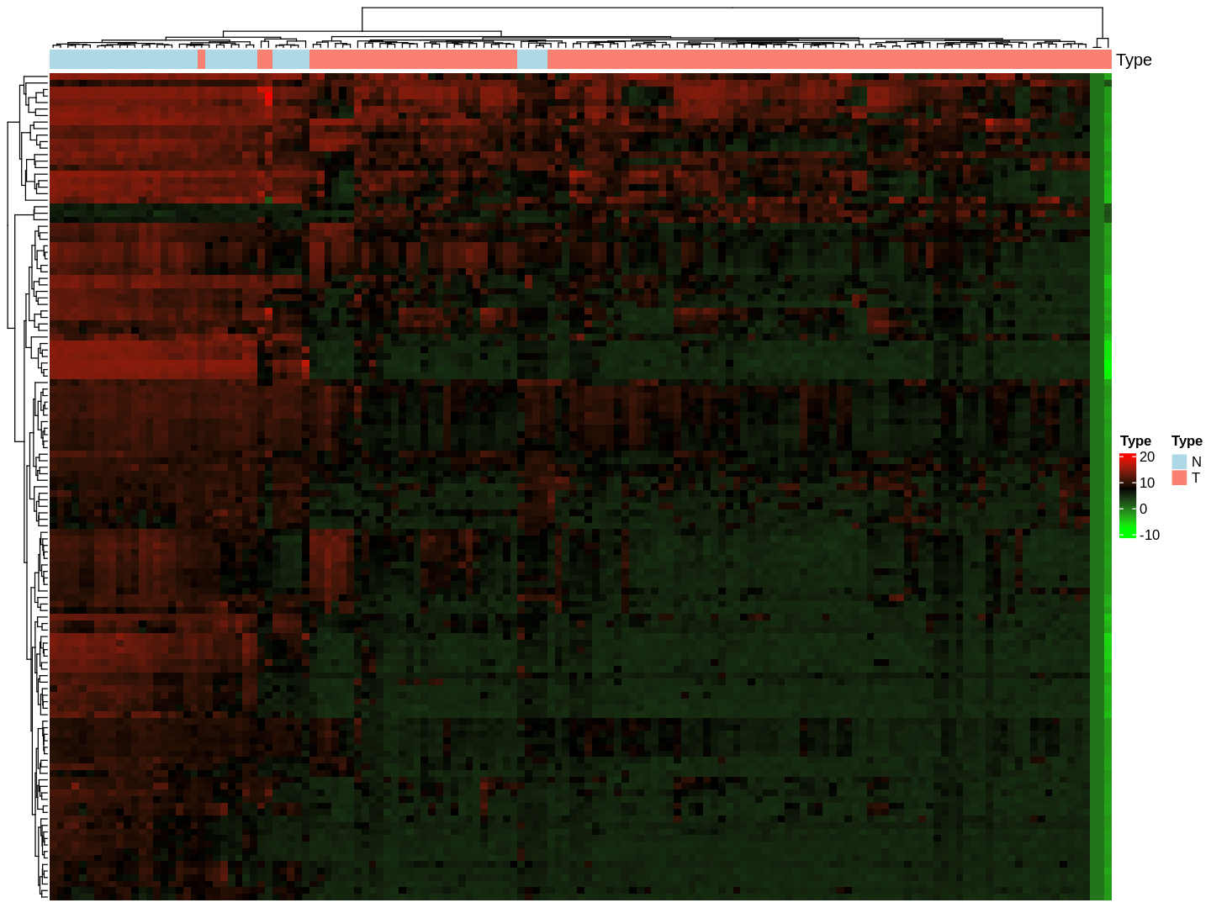
Heat map

Slide 15
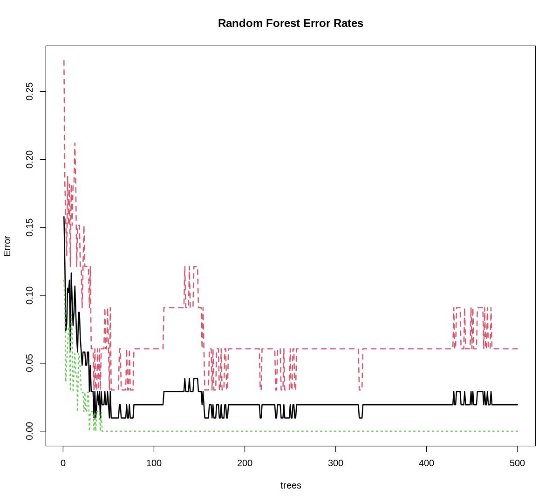
RF error rates

Slide 16
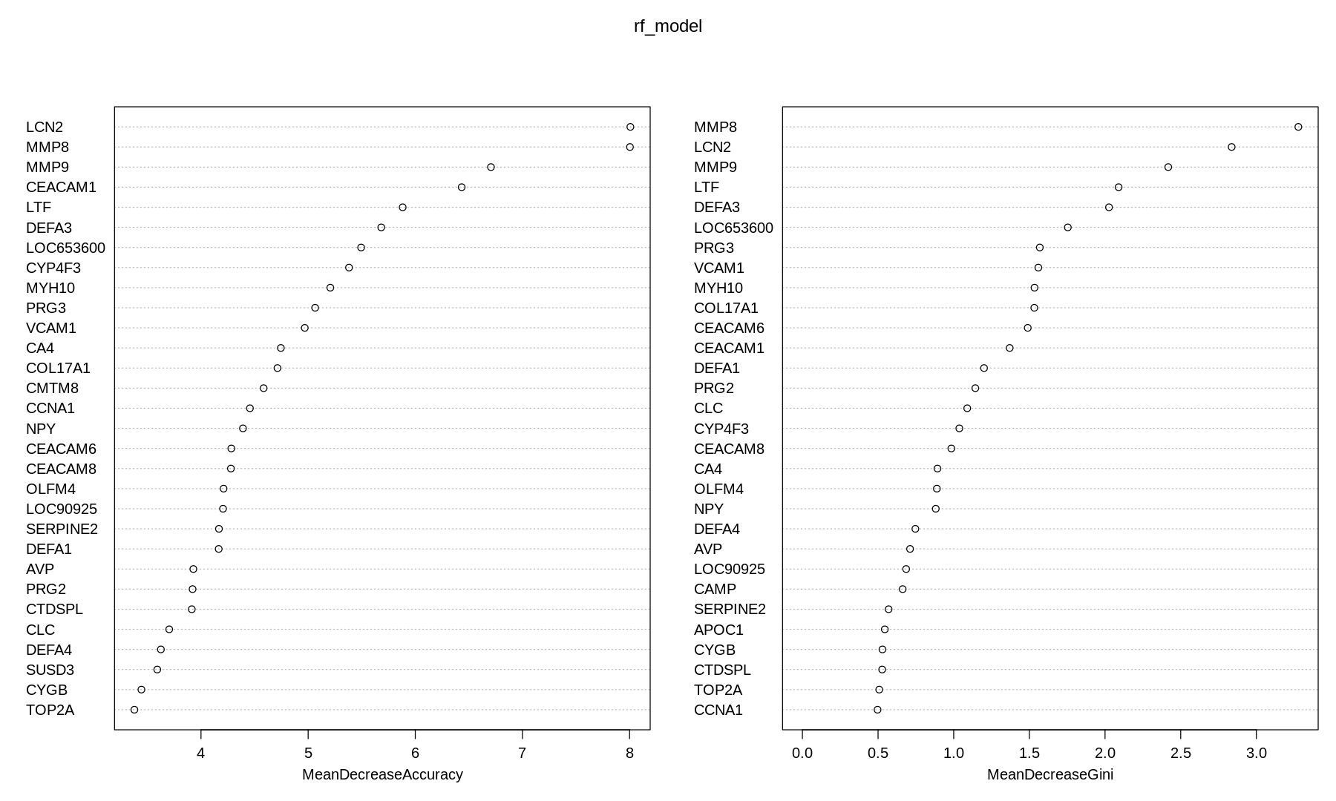
Mean decreased Gini plot

Slide 17
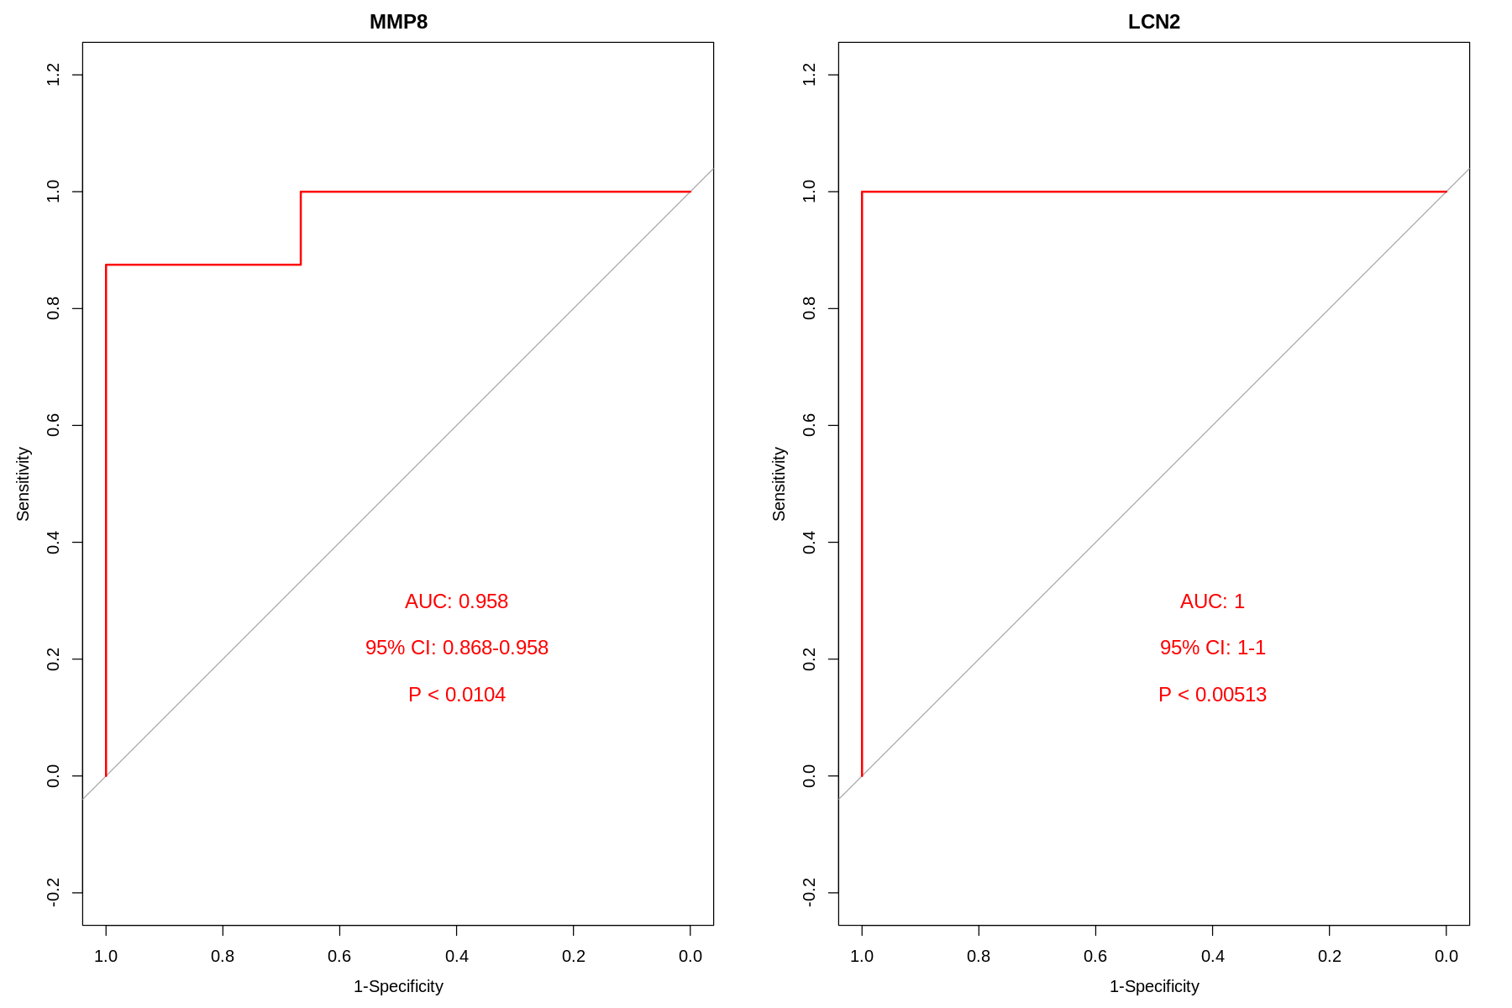
AUC

Slide 18
Enrichment analysis

Slide 19
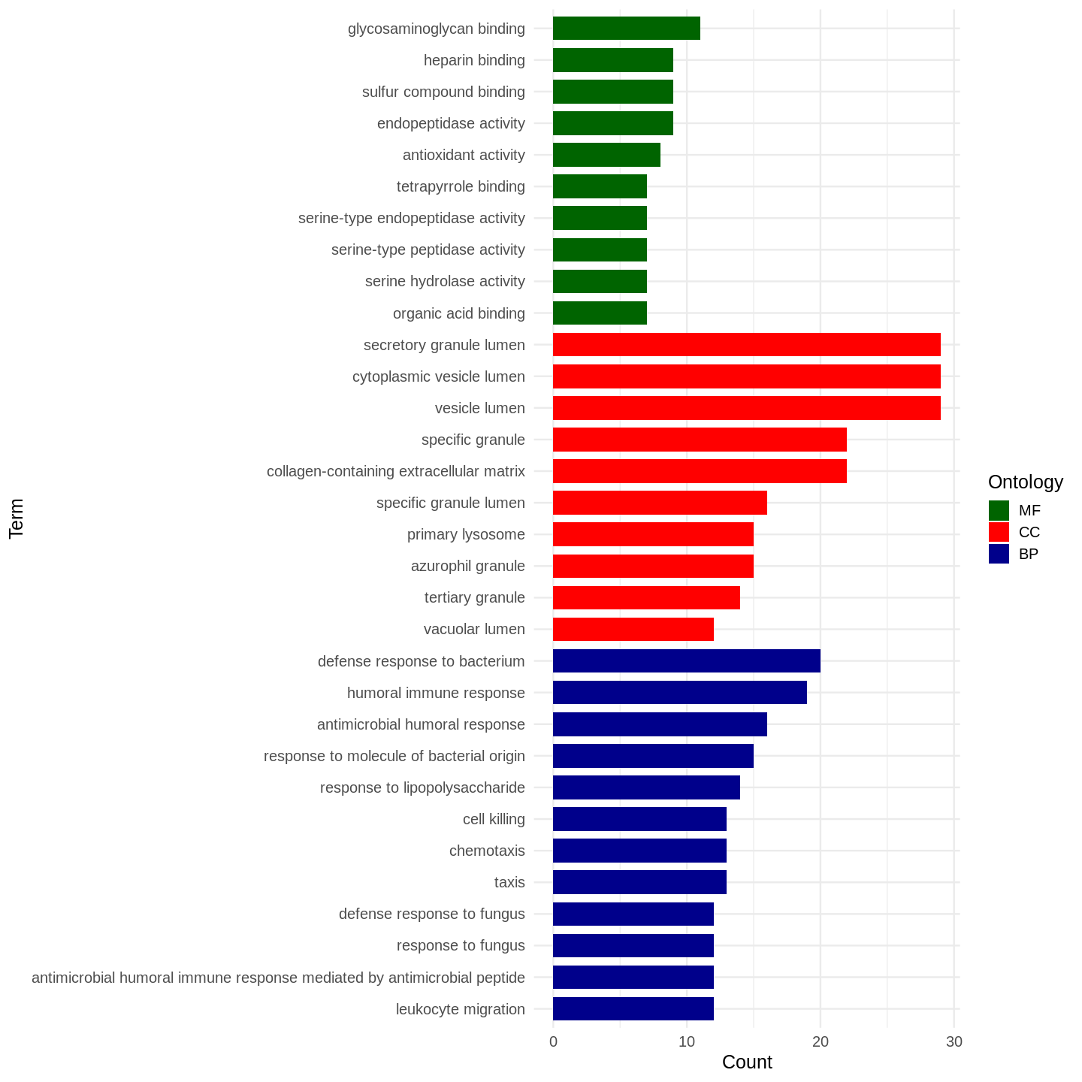
GO enrichment analysis

Slide 20
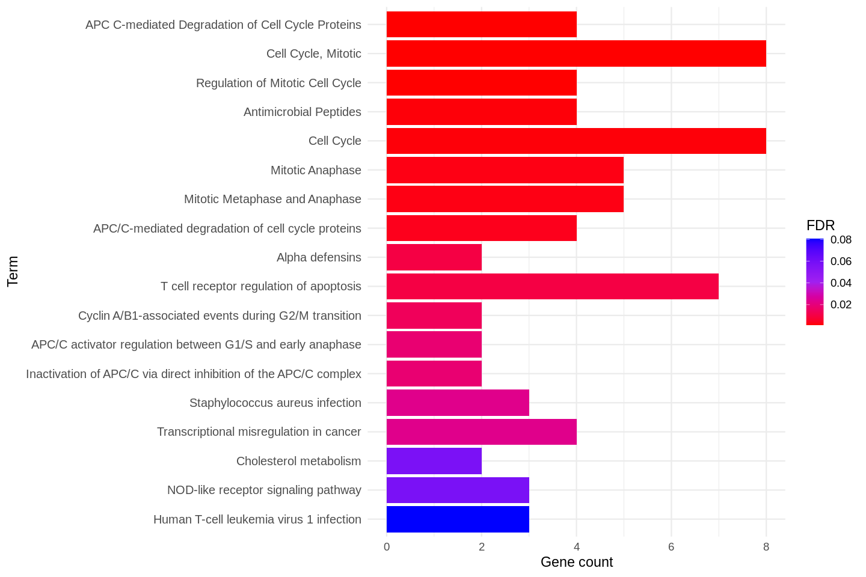
Pathway enrichment

Slide 21
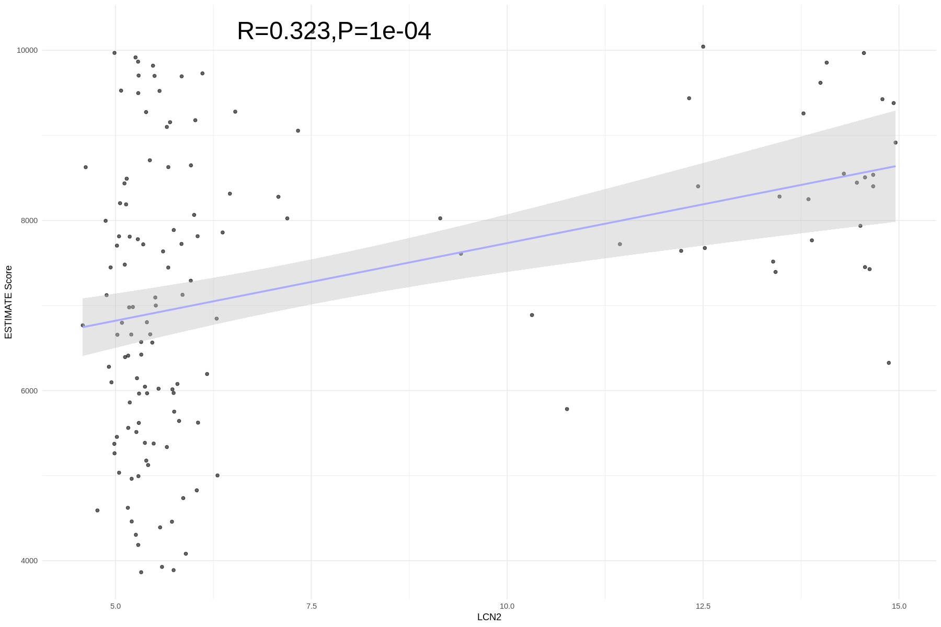
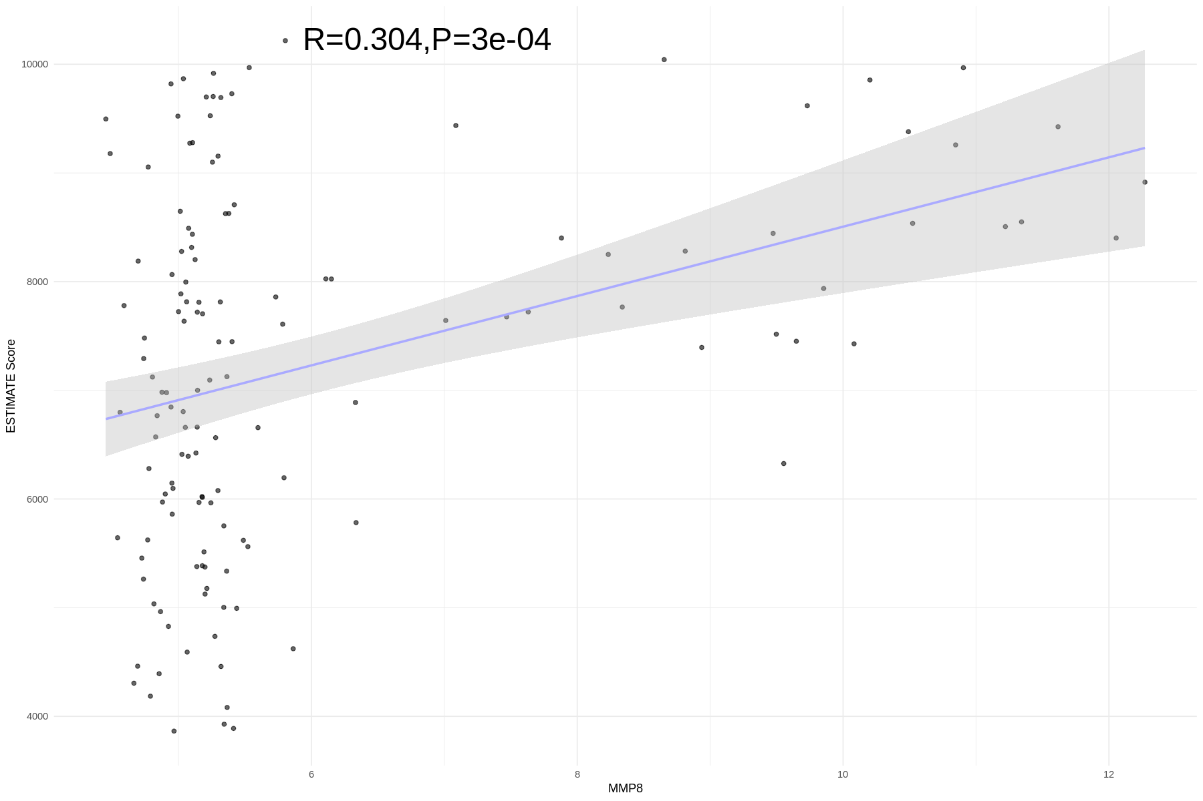
ESTIMATE
Estimation of STromal and Immune cells in MAlignant Tumor tissues using Expression data
LCN2
MMP8

Slide 22
Discussion & Conclusions
Ontology and pathways:
This analysis suggests a strong immune and extracellular matrix interaction, potentially linking inflammation, infection, and extracellular matrix remodeling.
Highly enriched processes are related to cell cycle control, mitosis, immune response, and infection.
Cancer-related processes (e.g., transcription misregulation, cell cycle deregulation) are prominent.
Immune system activation and antimicrobial responses suggest links to infection or immune-based therapies.
Metabolic pathways (cholesterol metabolism) may play a secondary role in disease mechanisms.

Slide 23
BioMarkers:
LCN2:
Encodes Lipocalin 2 (LCN2), a protein that binds small hydrophobic molecules like iron siderophores.
Promotes tumor growth, metastasis, and drug resistance.
Can be a biomarker for aggressive tumors.
Biomarker for cancer, inflammation, and metabolic disorders.
MMP8:
Encodes MMP8 (Collagenase-2), an enzyme that degrades extracellular matrix (ECM) components.
Can promote tumor invasion by degrading ECM.
In some cases, acts as a tumor suppressor by inhibiting angiogenesis.
Biomarker for inflammatory diseases and cancer.
There is a significant but moderate positive correlation between (MMP8, LCN2) and ESTIMATE score.
Both are overexpressed in various cancers and can influence tumor progression.
Potential combined biomarkers for cancer, inflammation, and metabolic disorders.

Slide 24
Thank you!
Any Questions?

